Slide 1
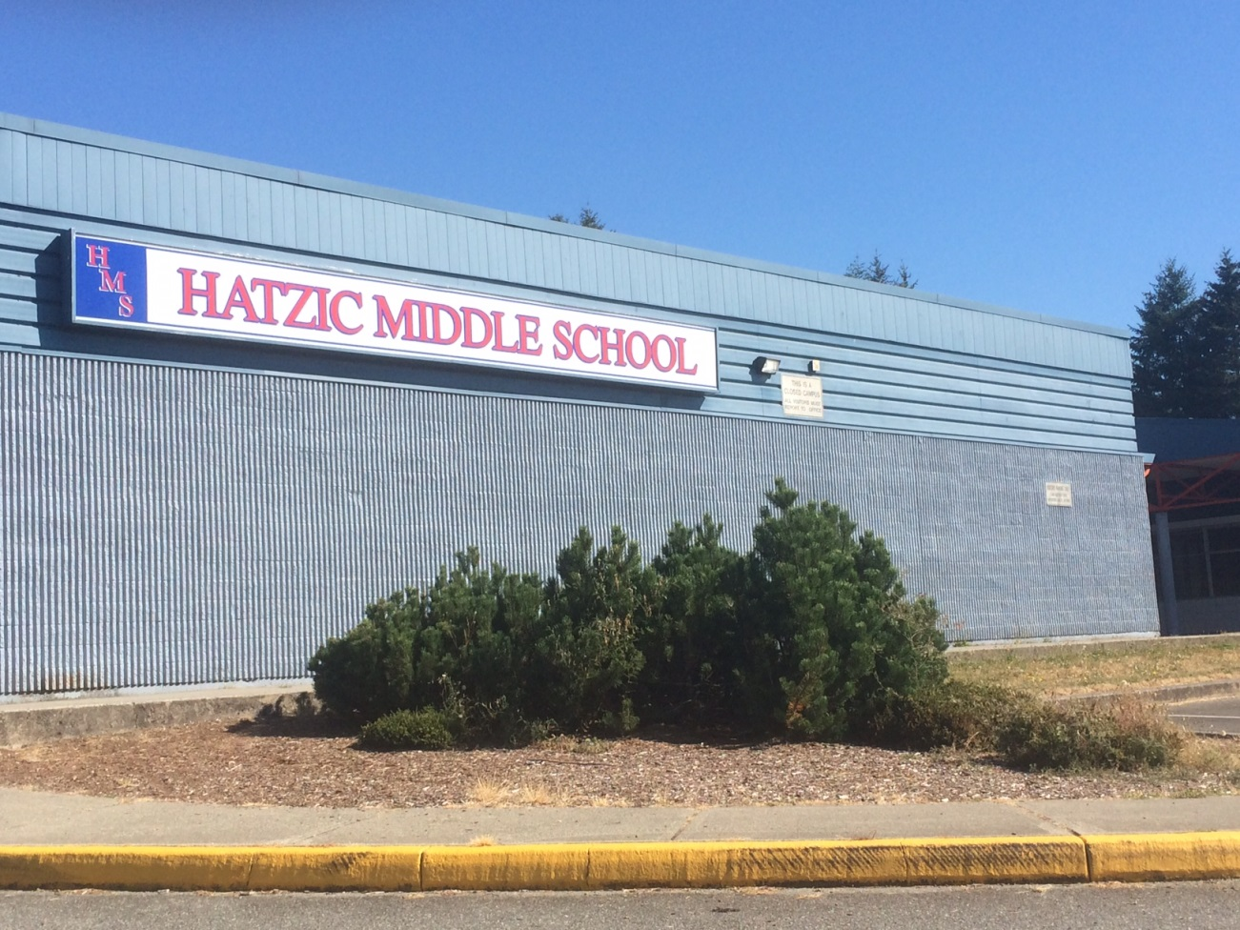
Welcome To HATZIC MIDDLE SCHOOL
EY KWE’SE XWE’I TEL HATZIC MIDDLE SCHOOL

Slide 2
School Administration:
Principal - Mr. Gabriele
Vice-Principal – Mrs. Vetter
Vice – Principal – Mr. Vos

Slide 3
School Counsellors:
Mrs. Curror
Mr. Barlett
Mrs. Hale
Youth Care Worker
Mrs. Velestuk

Slide 4
Indigenous Liaisons:
Ms. Schooner
Ms. Snow
Indigenous Success Coach
Ms. Brookes

Slide 5
Teachers
Currently we have 48 teachers on staff.
You will have several different teachers for different courses next year!
As many as 8 to 10 different teachers.

Slide 6
Schedule
Day 1 - Blocks - 1, 2, 3, 4
Day 2 - Blocks - 1, 2, 3, 4
Day 1 - Blocks - 4, 3, 2, 1
Day 2 - Blocks - 4, 3, 2, 1
Why?
To have courses at different times..

Slide 7
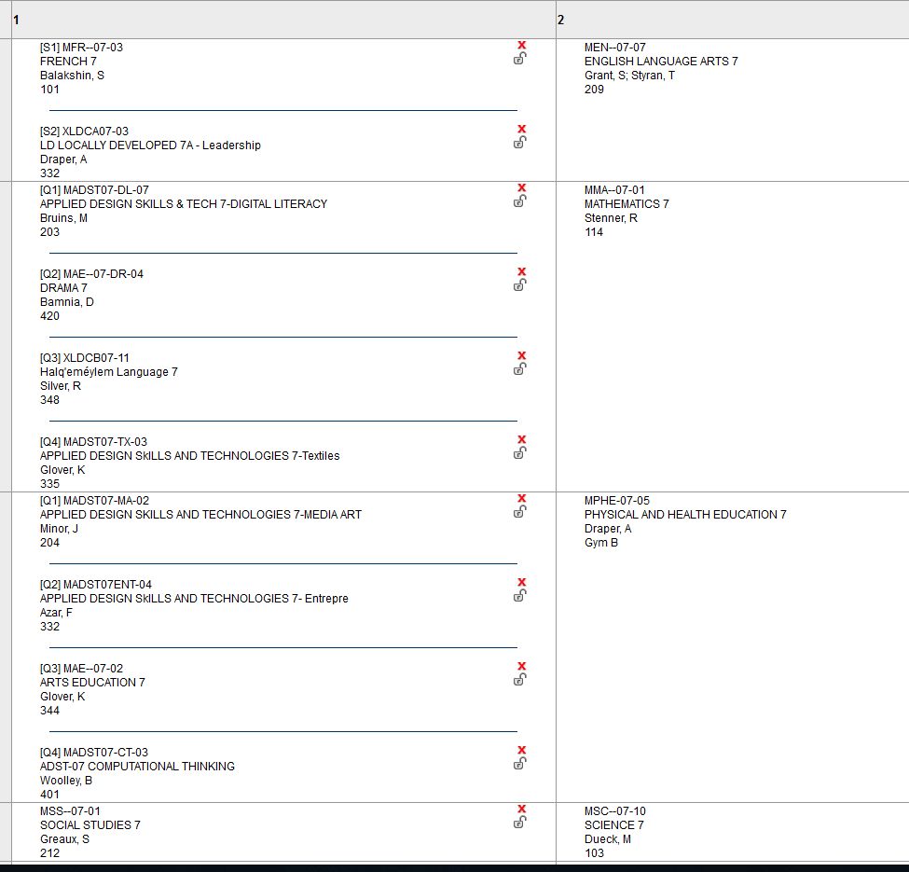
Typical Grade 7 Schedule

Slide 8
Download My school day
Phone App
This is where you will learn how to enter all of your classes and stay organized. Most everything that occurs at H.M.S will be posted on this App.

Slide 9
At Hatzic We Have
H.E.A.R.T

Slide 10
What is Hatzic H.E.A.R.T.?
Choose to have HEART everyday

Slide 11
At Hatzic We Have Heart
Practice Honesty
Engage in learning through Effort.
Embrace a positive Attitude.
Respect yourself, others and your surroundings.
Work to develop Teamwork Skills.

Slide 12
Classroom Expectations
Teachers will set expectations for their respective classrooms.

Slide 13
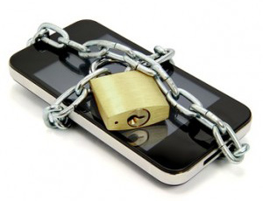
Technology
Is a learning tool when -
Needs to be stored safely when -
Your teacher gives permission to use technology in class.
You are under direct supervision of a teacher.
You are between classes, in the hallways, and in P.E. classes.
You are in class.
You are in the office area.

Slide 14
Personal Electronic Devices
Social Media sites such as Facebook, Instagram, snapchat, etc. are not to be accessed during instructional time.
Cell Phones are not to be taken into the hallways/washrooms during instructional time.
If referred to the office students may be required to forfeit phone to school administration where it will be safely stored.

Slide 15
Appearance and Dress Code
Clothing should:
Be appropriate for a learning/working environment.
Effectively cover the tops of shoulders, chest area, back and abdomen.
Undergarments must not be visible.
Proper gym strip is required for P.E.

Slide 16
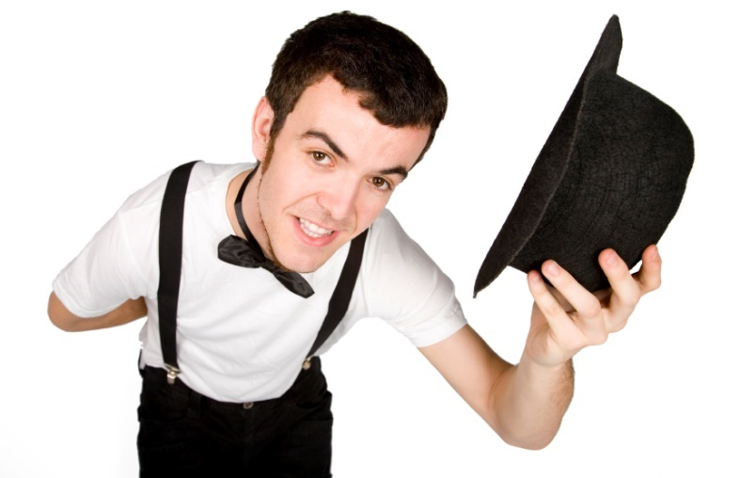
Hats
Please remove your hat when you enter the school.

Slide 17
Closed Campus
HMS is a closed campus. Students stay on campus all day.
If you are coming into the building after 9am, you will need enter through the front doors.
Students are not permitted to leave school grounds during lunch.
Any visitors to the school must check in to the office.

Slide 18
Ready for Lunch?
Cafeteria service is provided.
School store
Please respect the school environment by placing recycling and garbage in the appropriate containers.

Slide 19
Lockers
The lockers are the property of the school and are “rented” to students for the school year.
Locks will be given. Personal locks will not be permitted unless approved by school administration.
Keep locker combination confidential and do not share lockers.
The school administration can access any locker if deemed necessary.

Slide 20
Choose KIND everyday ….
Remember to say “Thank you” and “You’re Welcome”.
Say hello to staff and other students in the hallway.
Hold a door for someone, smile, say a compliment, speak kindly.

Slide 21
Plenty of Programs and Teams!
Be active and get involved in our school community.
Choir – Band - Hockey Academy
Wolfs Den and Drum Group
Lunch clubs are; Outdoor Club, Writing Club, Library Club, Hula Hoop Club, Anime Club, D and D Club, Dragster Club, Environmental Team, Art Club, Basketball and Weight Room at lunch.
School Sports Teams, Musical Theatre.
Track and Field.

